Slide 1
mmWave Sensing

Slide 2
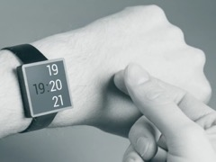
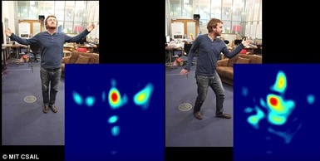
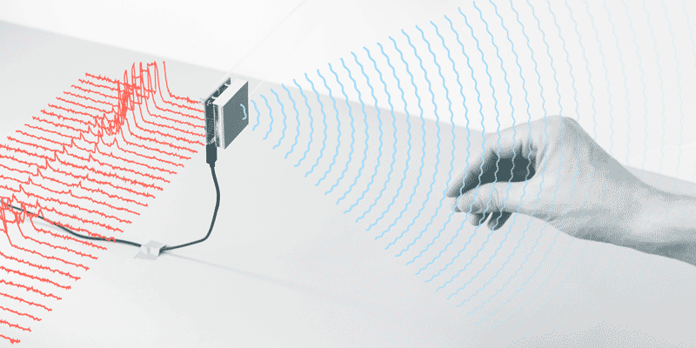
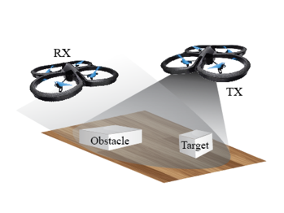
Bringing mmWave sensing to mobile devices
Reusing 60 GHz mobile devices for gesture recognition, localization/tracking, and imaging

Slide 3
Isn’t this the same as radar? No.
New opportunities: reusing mobile comm devices for sensing
Large-scale phased-array: high directionality and electronic steerability
Ubiquity and portability (similar to PC→Smartphone revolution)
More applications in IoT space (wireless health, HCI, etc.)
New challenges: need a redesign of sensing algorithms
Radios differ from radars
Uncontrolled mobility (different from airborne radar or airport mmWave imager)
Sophisticated reflection environment
Limited bandwidth and low computational capability

Slide 4
mTrack: reusing 60 GHz devices for passive tracking
Rx2
Tx
Pen
Rx
❶
60GHz laser-like directional beam
❷
Flexible beam-steering capability
❸
5mm extremely short wavelength
❹
More diffusive on small objects
* “mTrack: High Precision Passive Tracking Using Millimeter Wave Radios”, Teng Wei, Xinyu Zhang, ACM MobiCom’15

Slide 5
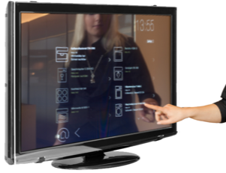
Targeted use cases
Building new mobile human computer interface through wireless sensing
Virtual Trackpad
Interactive Display
Wireless transcription
Turn any surface into interactive virtual touchscreen
Enable a new form of pervasive user-computer interface

Slide 6
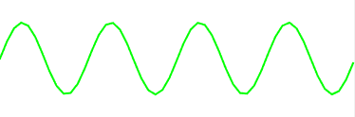
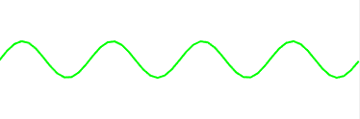
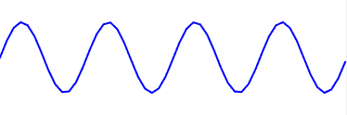
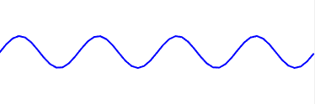
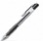
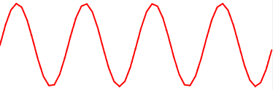
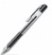
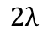

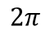
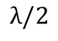
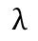
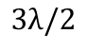
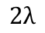
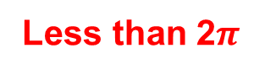

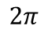
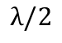
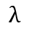
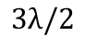
Key challenge: background reflection
Target Reflection
Background Reflection
Background Dominated
Objects in
the background
Tx
Rx
Rx
Target Dominated
Background Dominated
$$2π$$
$$2π$$
Phase of
Received
Signal
Phase of
Received
Signal
Less than 2$π$
$$0$$
$$0$$
$$λ/2$$
$$λ$$
$$3λ/2$$
$$2λ$$
$$λ/2$$
$$λ$$
$$3λ/2$$
$$2λ$$
Target movement
Target movement

Slide 7

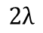
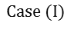
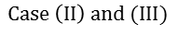
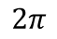
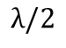
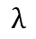
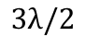
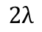

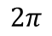
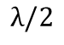
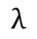
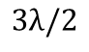

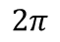
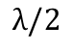
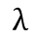
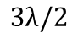
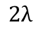
Solution: phase counting and regeneration
Periodicity Pattern of Phase
I (TD)
II (BD)
III (ITM)
$$2π$$
$$2π$$
$$2π$$
Phase
Phase
Phase
$$0$$
$$0$$
$$0$$
$$λ/2$$
$$λ$$
$$3λ/2$$
$$2λ$$
$$λ/2$$
$$λ$$
$$3λ/2$$
$$2λ$$
$$λ/2$$
$$λ$$
$$3λ/2$$
$$2λ$$
Target movement
Target movement
Target movement
PCR Algorithm
Step 1
$$Case (I)$$
$$Case \left(II\right) and (III)$$
$$Case (I)$$
Reducing ITM to BD
Input phase
3
0
-3
3
0
-5
Step 2
Periodicity Counting
1
0
3
0
-3
Step 3
Regeneration
0 50 100 150 200 250 300 350
Sample index

Slide 8
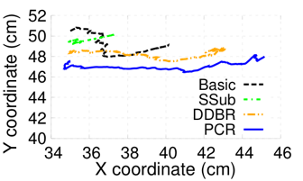
mTrack: performance overview
Tracking Setup
Result
Rx 1
Drywall
Tx
Rx 2
2m
10cm
10cm
Example trajectory of tracking
1m⨉1m
1.5m
Cabinet
1cm
Achieve cm to mm-level tracking
3cm
Error map over tracking region

Slide 9
Application and user study
Experiment Setup
Integrate mTrack into word-recognition application
Record hand-writing trace from mTrack
Export and control mouse of a PC
MyScript© Stylus for word detection
Example word
Recognition Accuracy

Slide 10



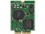
E-Mi: sensing assisted 60 GHz network deployment
Reverse engineering
Forward engineering
Reconstruct environment geometry/reflectivity by sampling radio channel
Predict the channel of arbitrarily located links
* “Facilitating Robust 60 GHz Network Deployment by Sensing Ambient Reflectors”, Teng Wei, Anfu Zhou, Xinyu Zhang, USENIX NSDI’17

Slide 11
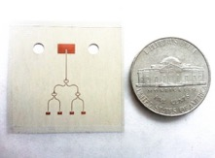
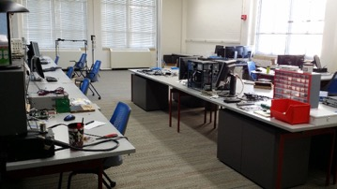
E-Mi: let mmWave radios “see” the environment
Radios: extremely low resolution sensors
Only a few “pixel sensors” (antenna elements)
From a mmWave radio’s eyes
From a camera’s eyes
Rx beam patterns
Tx beam patterns

Slide 12
Achieving super resolution
Model the environment as a sparse set of geometrical structures
Reconstruct the structure by tracing back the invisible propagation paths
Recover geometries of each path: AoA, AoD, length
Rx beam patterns
Tx
Rx
….
Tx beam patterns

Slide 13
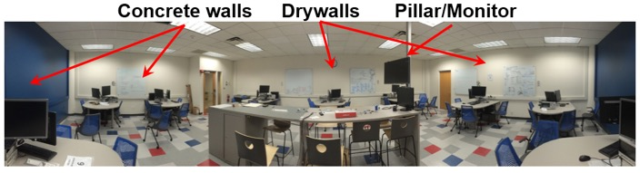
Example
Example: Sparse reconstruction of an office, using only 10 Rx positions
Centroid of virtual sources
Specular reflectors
Reflector boundaries
8.02m
Tx
diffusive reflector
11.10m

Slide 14


E-Mi: Sensing-assisted mmWave networking
Reflector-aware multi-AP deployment.
Key question:
For a set of APs in a given environment, how to deploy them optimally so as to maximize the coverage and robustness to blockage?
Solution principle
Reconstructing reflector position via wireless channel measurement
Predict signal strength distribution for an arbitrary deployment
Search for the best topology

Slide 15
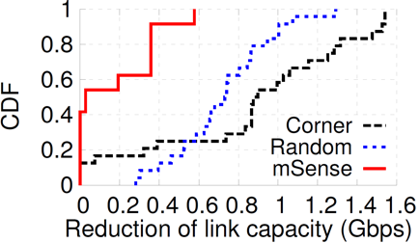
Prototyping and experimental results
2x to 5x higher performance than empirical deployment!
Link capacity reduction under random blockage
Link capacity distribution
50Mbps drop
600~800Mbps drop
2x ~ 5x
E-Mi
E-Mi
Notes:
[0:37] Our field tests showed that this approach can increase the average network capacity by 2 to 5 times, compared with empirical approaches that deploy the AP randomly or at corners.
It also makes the network more stable, the median throughput drop after blockage is only around 50 Mbps, in comparison to 600 to 800 Mbps when using empirical approaches.

Slide 16
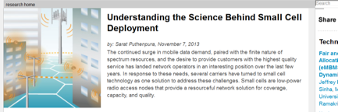
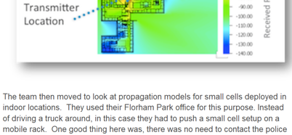
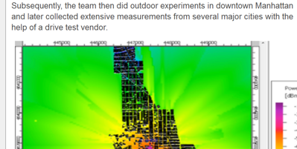
The impact of sensing on networking
AT&T’s patented Hetnet Analysis and Resource Planning technology (2013)
Site survey, or war-driving……
“Collected extensive measurement… with the help of a drive test vendor”
“Instead of driving a truck, they push a small-cell testbed on a mobile rack.”
Notes:
E-Mi is related with the literature of wireless network planning. That is, determining the best location to place access points or basestations, to achieve the best coverage.
But for many years, conventional network planning schemes require network engineers to move around, carrying radios or even mobile basestations with them, and do blanket measurement.

Slide 17
The impact of sensing on networking
War-driving is infeasible for mmWave networks
Beam steering + human blockage: infinite combinations!
E-Mi: a rigorous way of mmWave network planning
A computational wireless sensing model for network performance prediction
Many more possibilities: Environment aware beam adaptation; Intelligent reflector placement for wireless data centers; ……
Notes:
But for mmWave networks, this becomes infeasible, because there are numerous combinations of beam directions and human blockage patterns, and the test space is impossible to be covered by war-driving.
E-Mi essentially automates this procedure, by allowing the mmWave radios to sense the radio environment by themselves, and predict the network performance by themselves.
It opens up many opportunities to make the mmWave network robust and efficient.

Slide 18
Mobile mmWave imaging
Estimating object distance, curvature, boundary, and surface material
Fix TX, while moving RX to different locations; both using single-beam
Use reflected RSS patterns to distinguish object geometries/materials
* “Reusing 60 GHz Radios for Mobile Radar Imaging”, Yanzi Zhu, Yibo Zhu, Ben Y. Zhao and Haitao Zheng, ACM MobiCom’15

Slide 19
Mobile mmWave imaging
Ulysses: leveraging beamforming to improve signal diversity
Moving co-located TX/RX following predefined trajectory
* “Object Recognition and Navigation Using a Single Networking Device”, Yanzi Zhu, Yuanshun Yao, Ben Y. Zhao and Haitao Zheng, ACM MobiSys’17

Slide 20
Mobile mmWave imaging
Potentials and ultimate goals
Low-cost: < $50 (a typical 802.11ad tri-band NIC)
High-resolution: cm level (possible with large bandwidth and large phased-array)
Ubiquitous: 60 GHz phones/tablets already exist

Slide 21
References
* “mTrack: High Precision Passive Tracking Using Millimeter Wave Radios”, Teng Wei, Xinyu Zhang, ACM MobiCom’15
* “Facilitating Robust 60 GHz Network Deployment by Sensing Ambient Reflectors”, Teng Wei, Anfu Zhou, Xinyu Zhang, USENIX NSDI’17
* “Reusing 60 GHz Radios for Mobile Radar Imaging”, Yanzi Zhu, Yibo Zhu, Ben Y. Zhao and Haitao Zheng, ACM MobiCom’15
* “Object Recognition and Navigation Using a Single Networking Device”, Yanzi Zhu, Yuanshun Yao, Ben Y. Zhao and Haitao Zheng, ACM MobiSys’17
* “60 GHz Synthetic Aperture Radar for Short-Range Imaging: Theory and Experiments”, B. Mamandipoor, G. Malysa, A. Arbabian, U. Madhow and K. Noujeim, Asilomar, 2014
* “Capturing the Human Figure Through a Wall”, Fadel Adib, Chen-Yu Hsu, Hongzi Mao, Dina Katabi, Fredo Durand, ACM SIGGRAPH Asia, 2015

